Slide 1
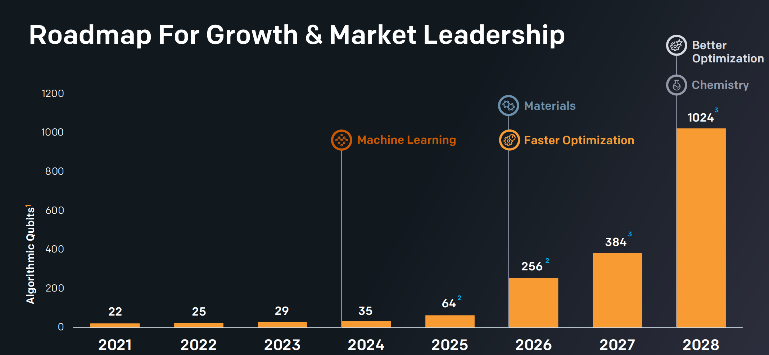

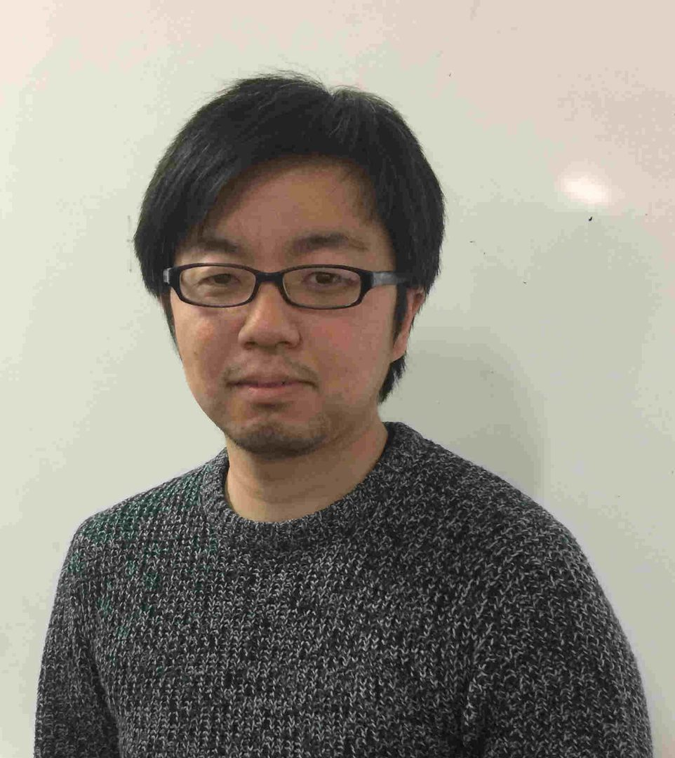
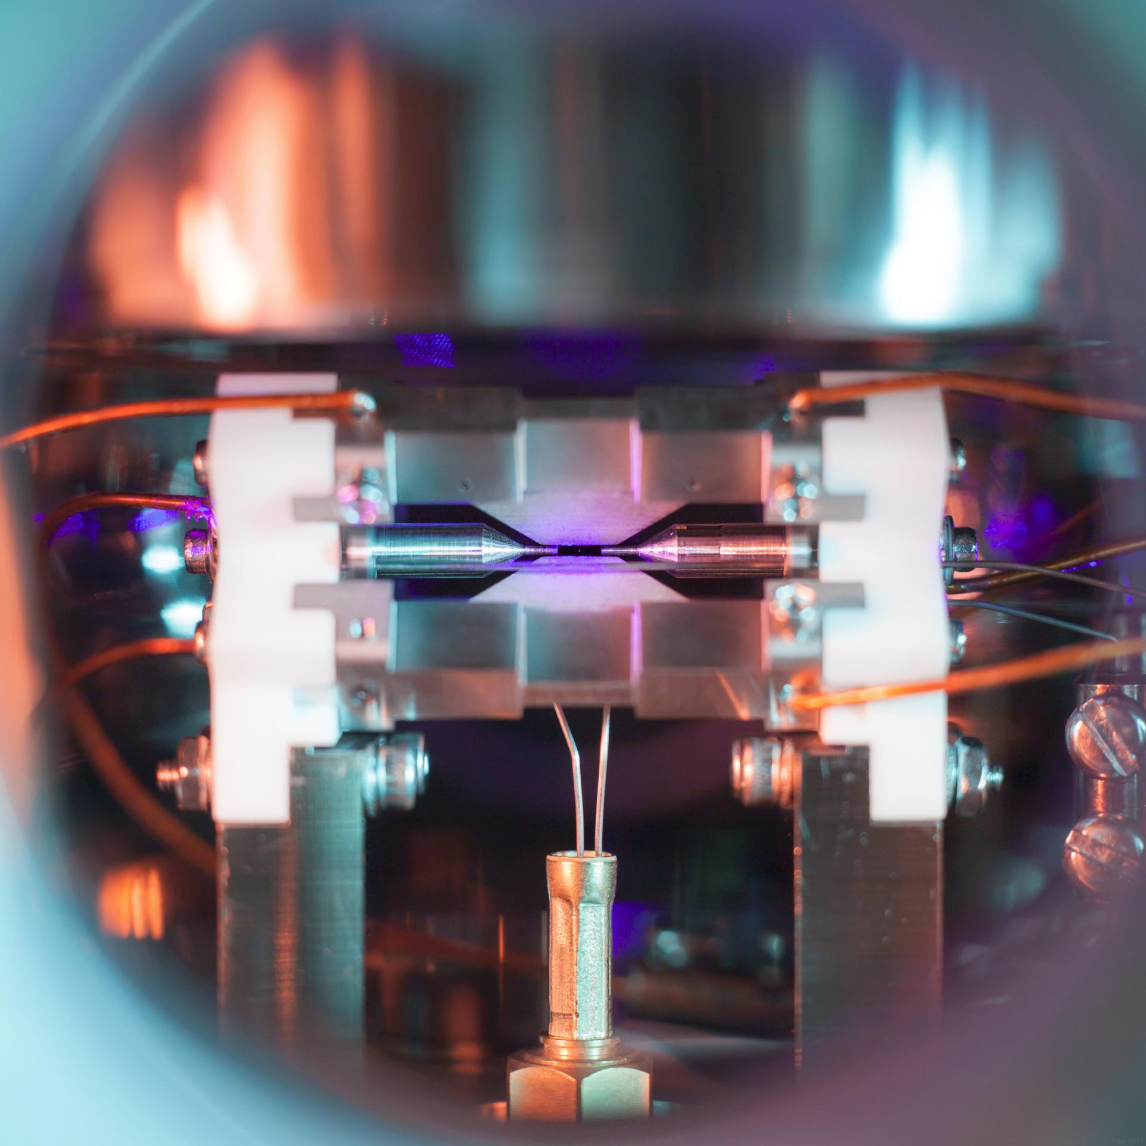
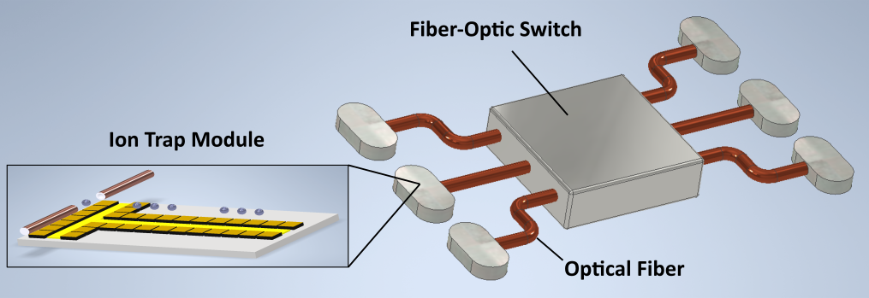
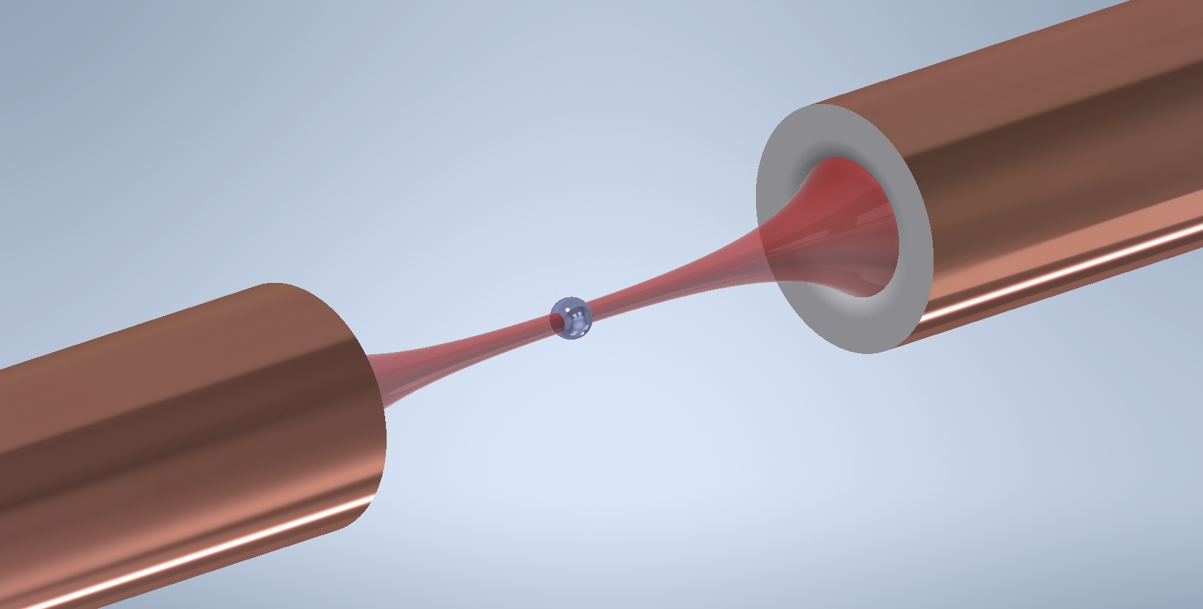
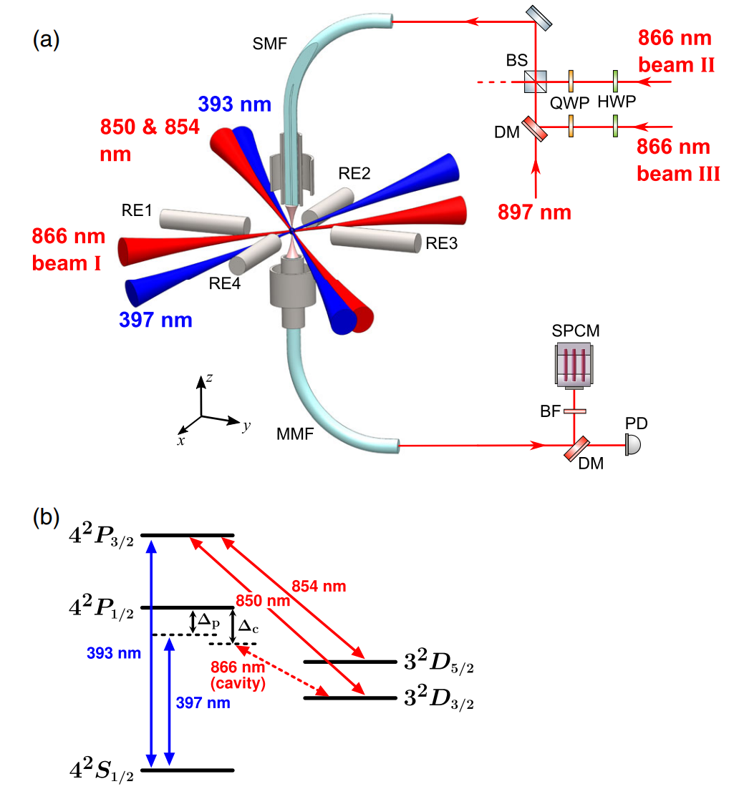
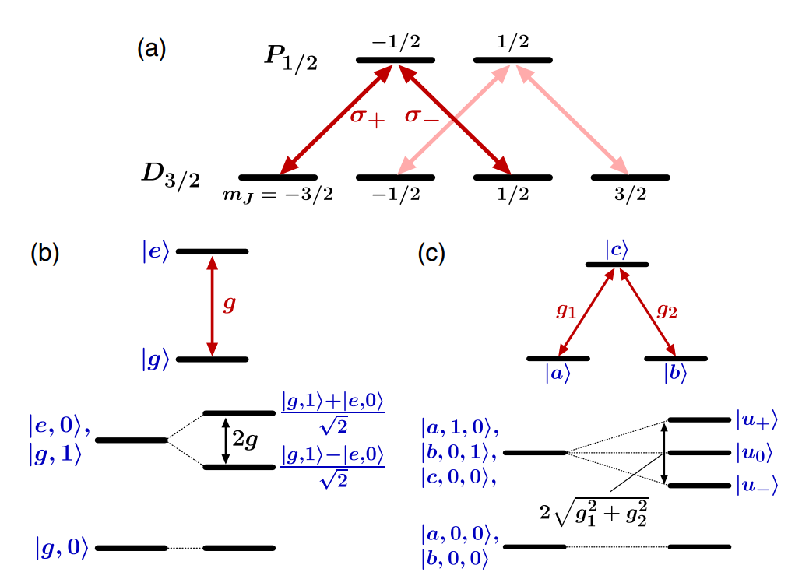
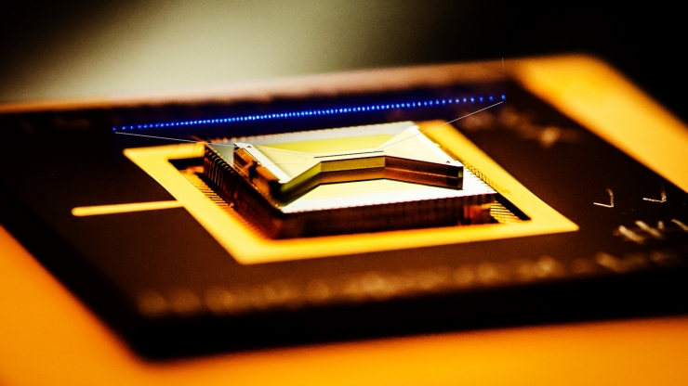
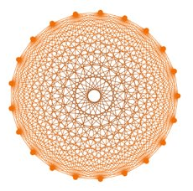
DiVincenzo Criteria
A scalable physical system with well-characterized qubit
The ability to initialize the state of the qubits to a simple fiducial state
Long relevant decoherence times
A "universal" set of quantum gates
A qubit-specific measurement capability
Trapped ions!
Problems with Scaling
All-optical access of qubits
Longest coherence times
Highest fidelity of operations
All qubits are identical
All-to-all connectivity is achieved
EQuIP Unit
Prof. Hiroki Takahashi
How to achieve it?
Individual Trapped Ions!
What we are doing: How: Optical cavities!
Strong coupling between ion and cavity is achieved
Connecting ion and cavity quantum states
David Nadlinger, Oxf uni
What happens when we scale?
Experimental setup
Ion's quantum levels

